Slide 1

Advertising Spend & Sales Optimization
A data-driven analysis of marketing channel efficiency and predictive modeling using linear regression.
MARKETING ANALYTICS REPORT

Slide 2
Exploratory Insights
Understanding media channel spend benchmarks and baseline correlations.

Slide 3

MEDIA MIX VOLUME BREAKDOWN
TV Dominates the Budget
The dataset shows a massive skew toward television advertising investments, averaging $147.04 across all tracking cycles.
Radio and newspaper strategies operate at significantly lower capital bounds, indicating they are historically treated as secondary support channels.

Slide 4






ATTRIBUTION & CHANNEL STRENGTH
TV Channel
Radio Channel
Newspaper Channel
0.782
0.350
0.228
Exceptional, dominant linear relationship with sales trajectory.
Moderate positive correlation. Useful multiplier effect when paired correctly.
Weak correlation index. Historically exhibits the lowest return footprint.

Slide 5

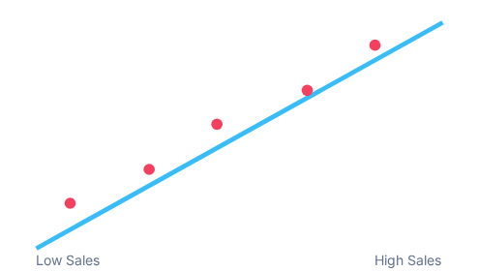

THE PREDICTIVE BASELINE MODEL
An OLS multiple linear regression pipeline was fitted combining all three marketing mediums simultaneously.
Evaluation Metric | Value / Capability
Model R² (Explanatory Power) | 0.897 (89.7%)
Residual Variance (MSE) | ~2.78 units
Red nodes indicate actual recorded sales matched against the model boundary.

Slide 6
SCENARIO MATRIX FORECASTING
Testing a Custom Allocations Mix
Using the multi-variable model equation, we simulated a speculative campaign budget parameters allocation:
19.43
•
$200.00 committed to Television media
•
$40.00 committed to Radio infrastructure
•
$50.00 split across target Regional Newspapers
Units Expected Sales
The prediction engine yields an optimization baseline of 19.43 product sale units, confirming immediate scalar growth when budgets scale upwards systematically.

Slide 7

WHAT HAPPENS IF WE DROP TV?
The Core Attribution Threat
If we intentionally execute strategy relying exclusively on Radio and Newspaper metrics while abandoning TV, model efficiency collapses.
The structural R² plunges down from 89.7% to just ~33%.
This drop confirms that alternative media arrays act primarily as secondary amplifiers; they cannot carry structural baseline demand generation alone.

Slide 8

NORMALIZATION MECHANICS
Preserved Optimization Performance
Transforming metrics with feature scaling filters (e.g., MinMax or StandardScaler) yields zero systemic variance on ultimate variance explanatory power or R² metrics.
TECHNICAL PIPELINE LOG
>> Raw Model R2: 0.89721
>> Normalized Model R2: 0.89721
The true utility resides in coefficient readability; normalizing unifies all relative media scales from raw dollars into comparative feature unit impacts.
Mathematical geometry behind linear projections remains invariant under uniform coordinate mapping scaling.

Slide 9



STRATEGIC ALLOCATION ARCHITECTURE
1. Protect the Anchor
2. Restructure Print
3. Continuous Track
Maintain TV advertising as the absolute anchor of customer volume generation frameworks.
Deprioritize Newspaper spend allocations. Shift excess print budgets into digital or radio conversion loops.
Deploy live multi-variable scenarios tracking to scale predictive confidence indices across operational quarters.

Slide 10

Thank You
Data Analysis & Predictive Spend Insights Complete

Slide 11

IMAGE SOURCES
https://honeykidsasia.com/thailand/wp-content/uploads/sites/2/2025/12/Untitled-design-3.jpg
Source: honeykidsasia.com

